Slide 1
Automated MRI Image Segmentation For Brain tumour Recognition
project team members:
Y . RaviKanth 314126510113
T . Krishna veni 314126510124
T . Manish 314126510099
B . Mounica 314126510138
UNDER THE GIUDANCE OF
P.NAGA SRINIVASU

Slide 2
JUSTIFICATION OF TITLE
Through the segmentation of MRI images and applying genetic algorithm, it makes the diagnosis more flexible (In majority of the cases the tumor is identified and the damaged/effected region of the image is highlighted) and it is comparatively accurate as it elevates the tumor through pixel intensities in a most precise way by normalizing the boundary pixels.

Slide 3
ABSTRACT
We propose adaptive brain tumour detection technique over a MRI Image that aids in recognition of tumours region in the brain. We are using Automated segmentation through multi-Objectives which include pre-processing and segmentation of image and finally estimating the entropy of the image to evaluate the segmented image. In the earlier stages median filter is being used to de-noise the mage and in further stages the entire image is assumed as 1D matrix and cross over and mutation operations were performed until the desired level of segmentation. It is expected that the experimental results of the proposed approach will exhibit better result in comparison to other existing systems.

Slide 4
LITERATURE REVIEW
MRI Segmentation Mechanisms
Semi-Automated Techniques
Automatic Techniques
K means
Fuzzy C means
Seeded Region Growing
KNN Mechanism
Genetic Algorithm Based
Water flow like lgorithm
Gravitaional search

Slide 5
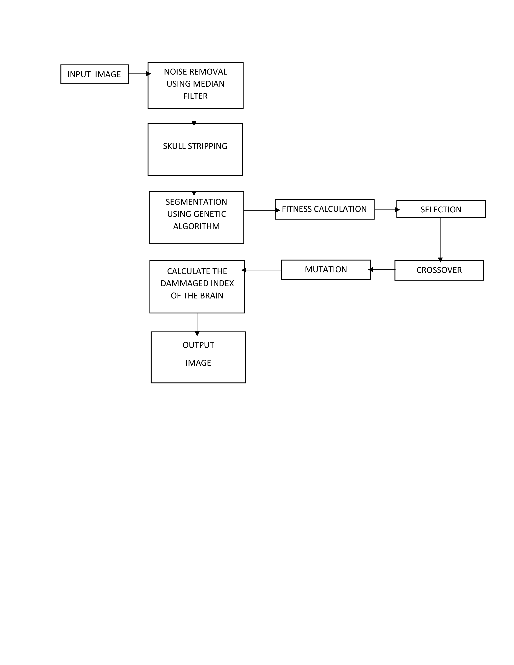
ARCHITECTURE

Slide 6
EXISTING SYSTEM
Detection of brain tumor is done in many ways. The existing systems are :
Using k-means clustering
Using fuzzy c –means
Using KNN Queries( k-Nearest Neighbors)
Seeded growing technique

Slide 7
PROPOSED SYSYTEM
In this we propose a fully automatic brain tissue classification from magnetic resonance images (MRI) The accurate segmentation of MR images into different tissue classes, especially gray matter (GM), white matter (WM) and cerebrospinal fluid (CSF) is a tough task so we use automated segmentation to divide the image into segments and use genetic algorithm to optimize the segmented image and to get the grey matter(GM) position ie the tumor region.

Slide 8
PSNR vs MSE Comparison Chart:
peak signal-to-noise ratio, often abbreviated PSNR, is an engineering term for the ratio between the maximum possible power of a signal and the power of corrupting noise that affects the fidelity of its representation. Because many signals have a very wide dynamic range, PSNR is usually expressed in terms of the logarithmic decibel scale.
PSNR is most easily defined via the mean squared error (MSE). Given a noise-free m×n monochrome image I and its noisy approximation K, MSE is defined as:
The PSNR (in dB) is defined as:
Here, MAX_{I} is the maximum possible pixel value of the image. When the pixels are represented using 8 bits per sample, this is 255. More generally, when samples are represented using linear PCM with B bits per sample, MAX_{I} is 2^{B}−1.

Slide 9
In statistics, the mean squared error (MSE) or mean squared deviation (MSD) of an estimator (of a procedure for estimating an unobserved quantity) measures the average of the squares of the errors or deviations—that is, the difference between the estimator and what is estimated. MSE is a risk function, corresponding to the expected value of the squared error loss or quadratic loss. The difference occurs because of randomness or because the estimator doesn't account for information that could produce a more accurate estimate.
The MSE is a measure of the quality of an estimator—it is always non-negative, and values closer to zero are better.
The MSE is the second moment (about the origin) of the error, and thus incorporates both the variance of the estimator and its bias. For an unbiased estimator, the MSE is the variance of the estimator. Like the variance, MSE has the same units of measurement as the square of the quantity being estimated. In an analogy to standard deviation, taking the square root of MSE yields the root-mean-square error or root-mean-square deviation (RMSE or RMSD), which has the same units as the quantity being estimated; for an unbiased estimator, the RMSE is the square root of the variance, known as the standard deviation.

Slide 10
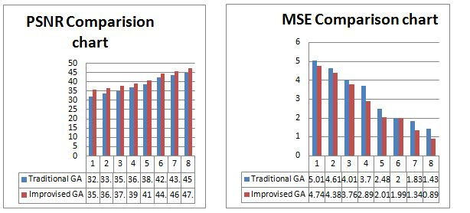

Slide 11
RMSE vs KAPPA INDEX COMPARISON:
The root-mean-square deviation (RMSD) or root-mean-square error (RMSE) (or sometimes root-mean-squared error) is a frequently used measure of the differences between values (sample and population values) predicted by a model or an estimator and the values actually observed. The RMSD represents the sample standard deviation of the differences between predicted values and observed values. These individual differences are called residuals when the calculations are performed over the data sample that was used for estimation, and are called prediction errors when computed out-of-sample. The RMSD serves to aggregate the magnitudes of the errors in predictions for various times into a single measure of predictive power. RMSD is a measure of accuracy, to compare forecasting errors of different models for a particular data and not between datasets, as it is scale-dependent.
RMSD is the square root of the average of squared errors. The effect of each error on RMSD is proportional to the size of the squared error; thus larger errors have a disproportionately large effect on RMSD. Consequently, RMSD is sensitive to outliers.

Slide 12
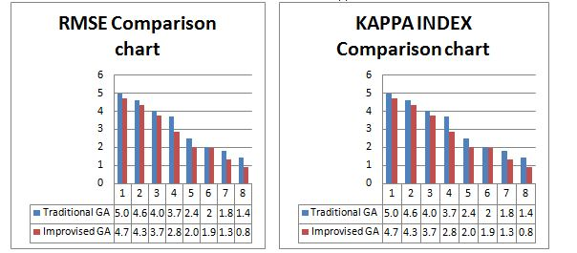
Cohen's kappa coefficient (κ) is a statistic which measures inter-rater agreement for qualitative (categorical) items. It is generally thought to be a more robust measure than simple percent agreement calculation, as κ takes into account the possibility of the agreement occurring by chance. There is controversy surrounding Cohen’s Kappa due to the difficulty in interpreting indices of agreement. Some researchers have suggested that it is conceptually simpler to evaluate disagreement between items.

Slide 13
NOISE REMOVAL
We read a MRI image and remove noise from the image using some functions
Kaverage = filter2(fspecial('average',3),J)/255;
Kmedian = medfilt2(J);
imshowpair(Kaverage,Kmedian,'montage')
To know the affected part we apply Automated segmentation. Later we take the segmented values in a array of elements and apply Genetic algorithm to optimize the image to get the grey part(GM) of the image that is the affected area of tumour .

Slide 14
IMAGE RESIZING
Resizing the input image to a certain size can result in better application of noise removal and segmentation techniques which are crucial elements of this project.
We achieve this by using the ‘imresize’ function available in matlab
I=imread('brainimg1.jpg');
B=imresize(I,[512 512]);
This results in an 512*512 image irrespective of the size of image at the time of input.

Slide 15
GENETIC ALGORITHM
GA’s simulate the survival of the fittest among individuals over consecutive generation for solving a problem. Each generation consists of a population of character strings that are analogous to the chromosome that we see in our DNA. Each individual represents a point in a search space and a possible solution. The individuals in the population are then made to go through a process of evolution.
GAs are based on an analogy with the genetic structure and behavior of chromosomes within a population of individuals using the following foundations:
Individuals in a population compete for resources and mates.
Those individuals most successful in each 'competition' will produce more offspring than those individuals that perform poorly.
Genes from `good' individuals propagate throughout the population so that two good parents will sometimes produce offspring that are better than either parent.
Thus each successive generation will become more suited to their environment.

Slide 16
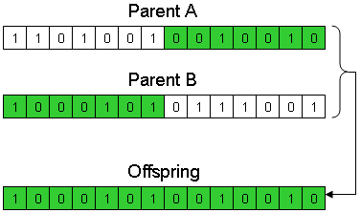
CROSSOVER

Slide 17
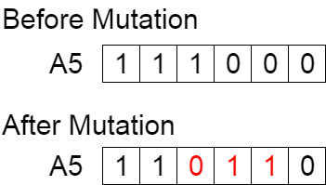
MUTATION

Slide 18
SKULL STRIPPING
We have performed skull stripping using morphological operations. The following are the steps:
Crop the image
Convert image into binary image
Seal off the bottom of the head - make the last row white.
Erode away 15 layers of pixels.
Mask the gray image

Slide 19
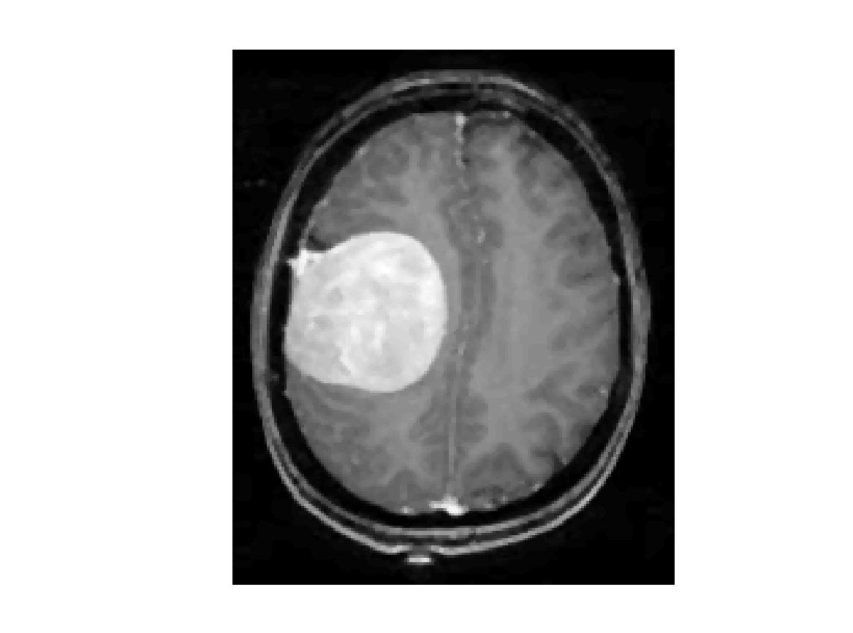
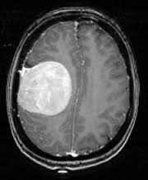
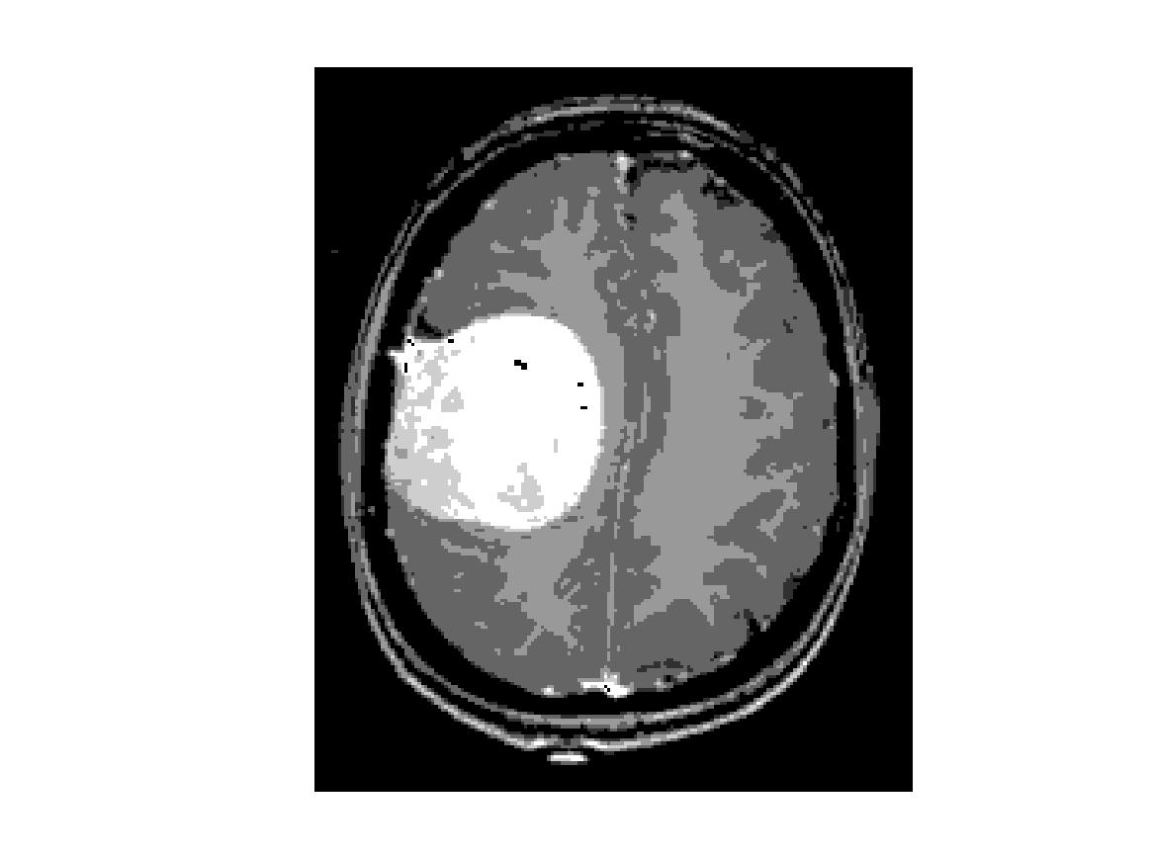
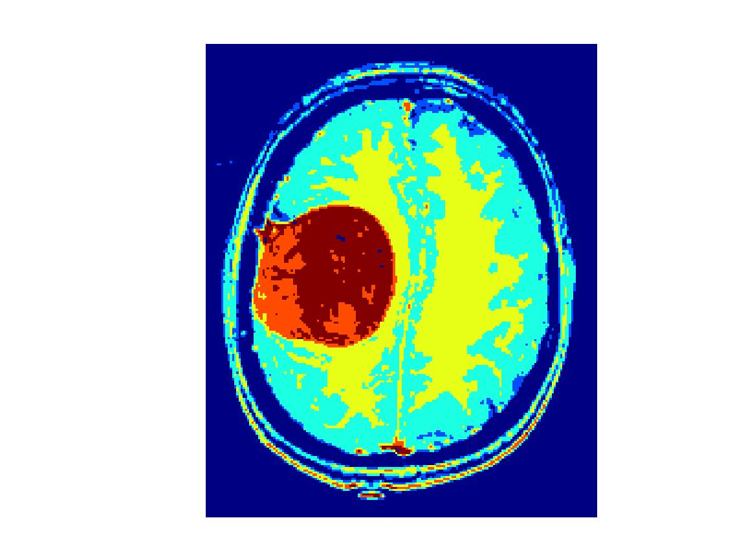
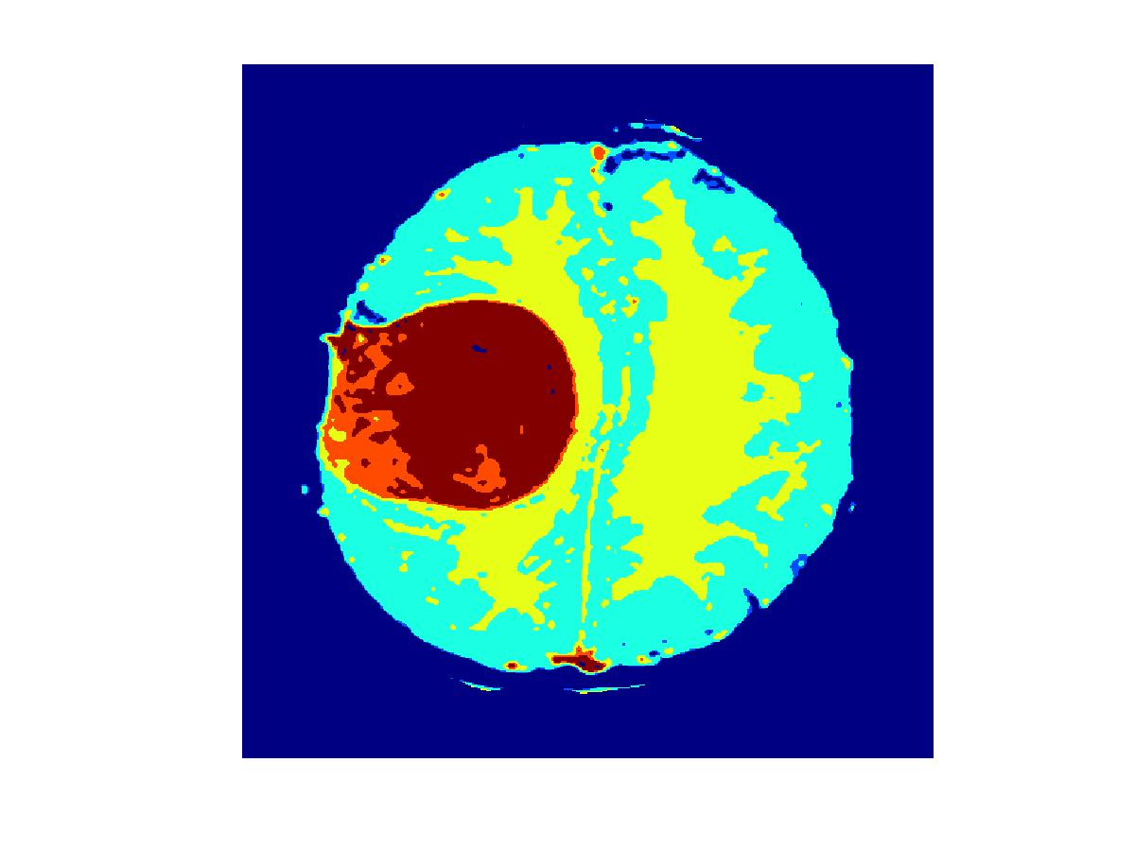
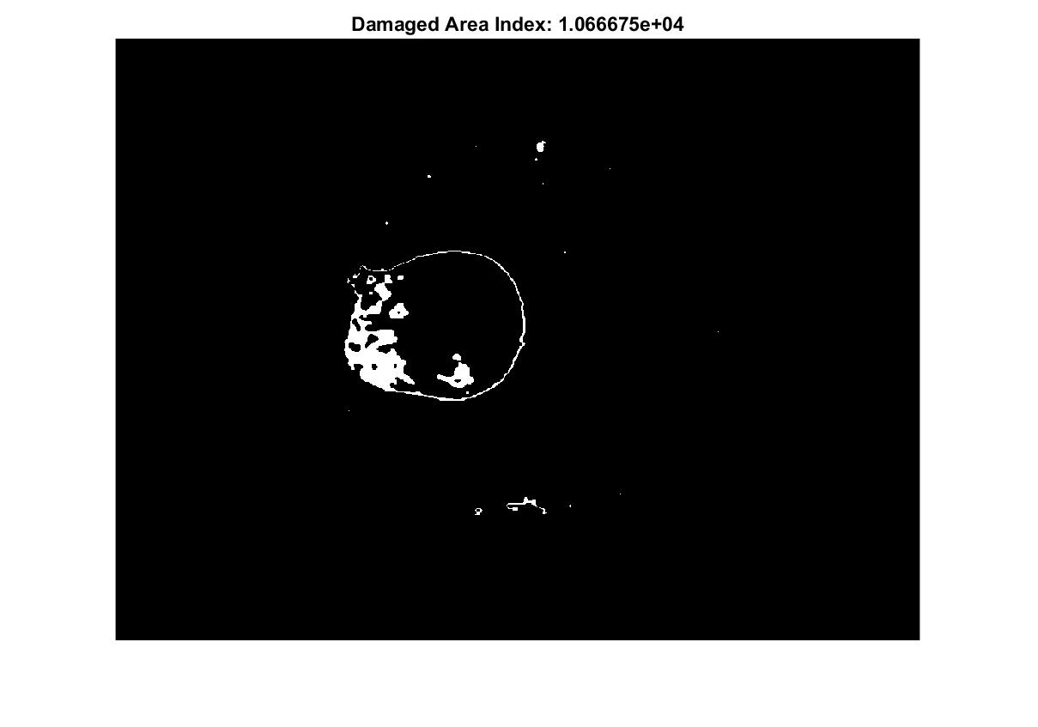
RESULTS
INPUT 1.AFTER NOISE REMOVAL 2.APPLYING GENETIC
ALGORITHM
3. AFTER APPLYING 4.AFTER SKULL 5.DAMAGE INDEX
COLORMAP STRIPPING

Slide 20
THANK YOU !

